Slide 1

Basic Details of the Team and Problem Statement
Ministry/Organization Name/Student Innovation: Ministry of Law and Justice
Government of NCT of Delhi IT Department, GNCTD
PS Code: SIH 1620
Problem Statement Title: Queuing models in OPDs/ availability of beds/ admission of patients. A hospital based solution is ideal which can be integrated with city wide module
Team Name: MediWave
Team Leader Name: Afzal Ahmed Siddiquie
Institute Code (AISHE): C-33880
Institute Name: Don Bosco Institute of Technology, Mumbai
Theme Name: MedTech / BioTech / HealthTech

Slide 2
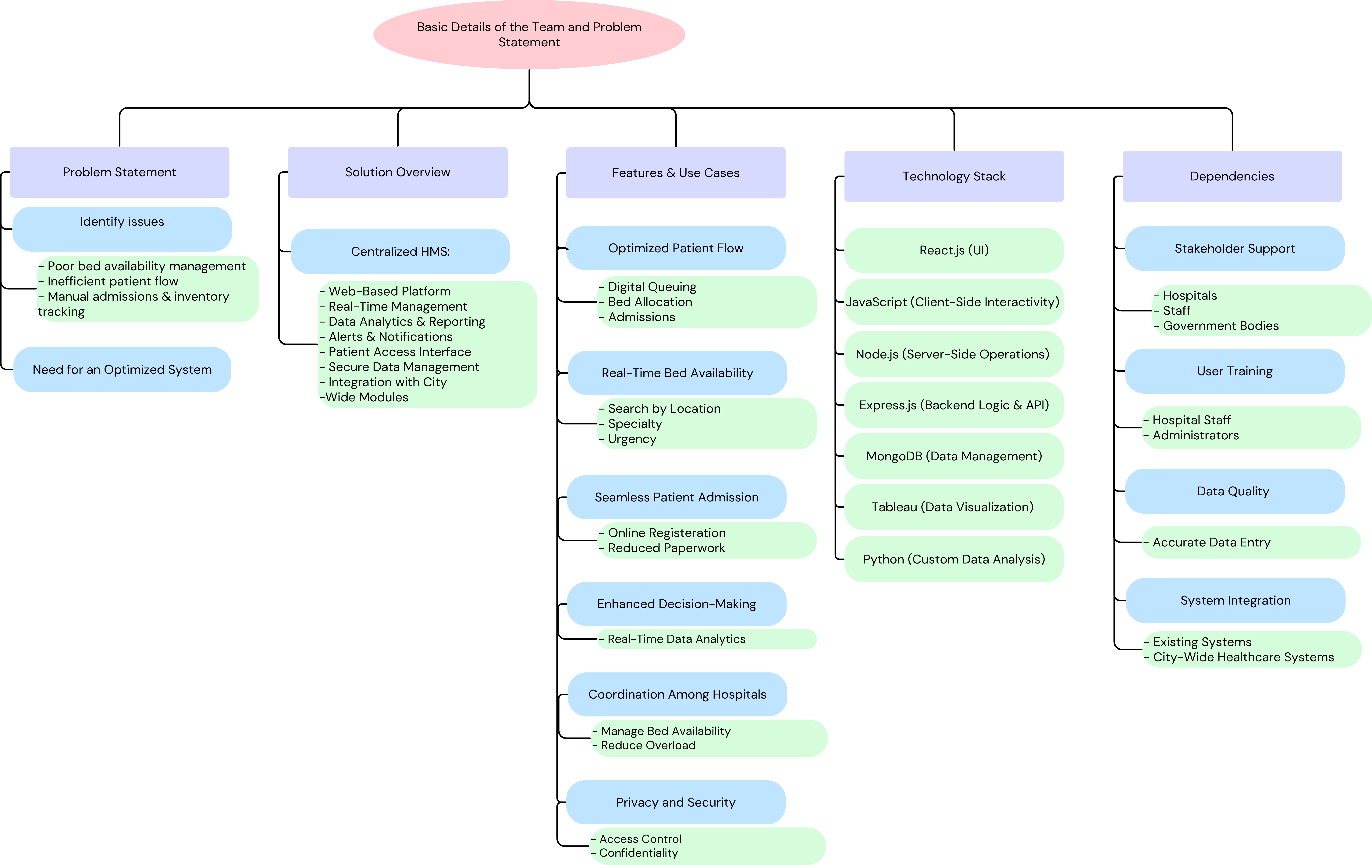
Idea/Approach Details
Solution:
➢ We propose a centralized web-based Hospital Management System (HMS) that optimizes patient flow, bed availability, admissions, and inventory management in healthcare facilities.
➢ Authorized personnel can enter, track, and manage OPD queues, bed assignments, and admissions in real-time.
➢ It features data analytics for generating reports on patient flow, bed usage, and resource allocation for better decision-making.
➢ Alerts notify staff of upcoming appointments, admissions, discharges, and bed availability.
➢ Real-time data on bed availability ensures efficient resource utilization and coordination between hospitals.
➢ Patients can access an interface to check wait times, bed availability, and book appointments online.
➢ Patient data is securely managed, accessible only to authorized users, ensuring privacy.
➢ The system integrates with city-wide modules for a comprehensive view of resource availability and patient management.
Dependencies
⮚ Stakeholder Support: Engagement from hospitals, staff, and government bodies is vital for implementation.
⮚ User Training: Ensuring hospital staff and administrators are properly trained for effective system adoption.
⮚ Data Quality: Accurate, high-quality data entry is critical for decision-making and analytics.
⮚ System Integration: Seamless integration with existing hospital and city-wide healthcare systems for interoperability.

Slide 3
Idea/Approach Details
Technology Stack:
⮚ Optimized Patient Flow: Digitizes queuing, bed allocation, and admissions, saving time for patients and staff.
⮚ Real-Time Bed Availability: Allows searching for available beds by location, specialty, and urgency to reduce wait times.
⮚ Seamless Patient Admission: Facilitates online registration and admission, reducing paperwork for hospitals.
⮚ Enhanced Decision-Making: Provides real-time data analytics for better resource allocation and facility management.
⮚ Coordination Among Hospitals: Enhances communication between hospitals to manage bed availability and reduce overload.
⮚ Automated Notifications: Sends alerts for appointments, admissions, and bed status to keep staff informed.
⮚Privacy and Security: Ensures sensitive patient records are accessible only to authorized users, maintaining confidentiality.
Technology Stack:
⮚ React.js: For building a responsive and dynamic user interface (UI).
⮚ JavaScript: Ensures client-side interactivity and enhances user experience.
⮚ Node.js: Provides a powerful runtime environment for server-side operations.
⮚ Express.js: A robust web framework for Node.js to handle the backend logic and API management.
⮚ MongoDB: A NoSQL database used for storing and managing healthcare data efficiently.
⮚ Tableau: Generates insightful data visualizations to enhance decision-making and reporting.
⮚ Python: Used for custom data analysis, implementing advanced algorithms for healthcare insights.

Slide 4
Team Member Details
Team Leader Name: Afzal Ahmed Siddiquie
Branch: BE Stream: IT Year: IV
Team Member 1 Name: Abhay Singh
Branch: BE Stream: IT Year: IV
Team Member 2 Name: Shriya Thakur
Branch: BE Stream: IT Year: IV
Team Member 3 Name: Shravani Shinde
Branch: BE Stream: IT Year: IV
Team Member 4 Name: Kainaat Zaidi
Branch: BE Stream: IT Year: IV
Team Member 5 Name: Nigel Silveira
Branch: BE Stream: IT Year: IV
Team Mentor 1 Name: Type Your Name Here
Category (Academic/Industry): Expertise (AI/ML/Blockchain etc): Domain Experience (in years):
Team Mentor 2 Name: Type Your Name Here
Category (Academic/Industry): Expertise (AI/ML/Blockchain etc): Domain Experience (in years):

